Slide 1

SHIP-BREAKING:
Creating Accountability
By Steven Kazan, Esq.
Kazan McClain Satterley & Greenwood, a Professional Law Corporation

Slide 2
Disclosure
I am senior partner of Kazan, McClain, Satterley & Greenwood, a Professional Law Corporation, a law firm whose practice focuses on representing patients with mesothelioma, with income entirely derived from asbestos-related industries, their insurers, and related trust funds.

Slide 3
What is Ship-Breaking?
Ship-breaking is a practice where ocean-going vessels are run aground onto tidal mudflats and beaches for dismantling.
90% of the world’s ship-breaking is done in Bangladesh, China, India, Pakistan and Turkey; an unsustainable, environmentally damaging and often deadly industry.

Slide 4
“One can speculate that a single batch of asbestos mined in the 1930s could have resulted in plaques and asbestosis in Canadian miners in the 1960s, lung cancer and mesothelioma in US shipyard workers in the 1970s, and in the future, result in lung disease in Indian and Pakistani ship-breakers in the 2010s, and mesothelioma in the 2030s in Indians and Pakistanis exposed currently as children to improperly discarded asbestos waste.”¹
This speculation is proving true.
1. Beckett, William S. "Shipyard workers and asbestos: a persistent and international problem." (2007): 639-641.

Slide 5
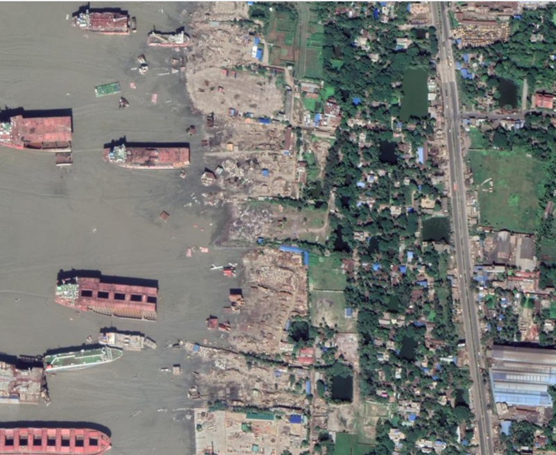
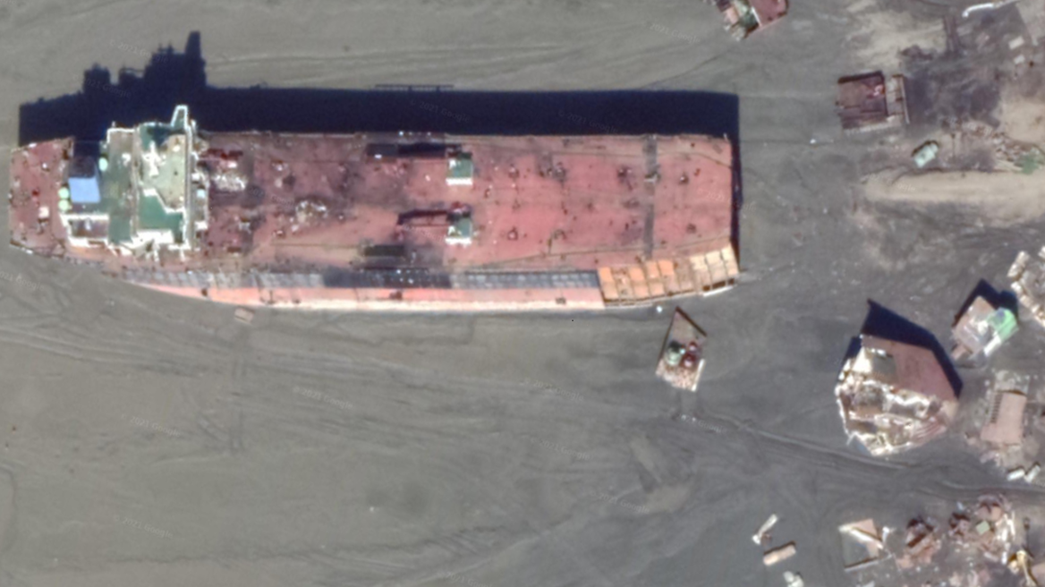
Chittagong Beach Bangladesh Google satellite accessed 3/8/2021

Slide 6
The International Labour Organization has called ship-breaking one of “the most dangerous jobs in the world”.
Since 2009, there have been 6,430 ships beached, with 398 deaths caused by fires, explosions and traumatic injuries caused by falling steel plates.²
These numbers are under-reported, and ignore occupational diseases, including mesothelioma, that may not manifest for up to 40 years.
Decommissioned ships contain carcinogenic and toxic substances, with an average ship containing up to 7 tonnes of asbestos, presenting serious risks to the workers, their families and to the environment.
2. https://www.shipbreakingplatform.org/

Slide 7
Where is asbestos found on a ship?
Asbestos is found on ships in many types of materials, including, but not limited to:
• Bulkhead and pipe thermal insulation • Molded plastic products (e.g. switch
• Bulkhead fire shields/fireproofing handles, clutch facings)
• Uptake space insulation • Sealing putty
• Exhaust duct insulation • Packing in shafts and valves
• Electrical cable materials • Packing in electrical bulkhead penetrations
• Brake linings • Asbestos arc chutes in circuit breakers
• Floor tiles and deck underlay • Pipe hanger inserts
• Steam, water, and vent flange gaskets • Weld shop protectors and burn covers,
• Adhesives and adhesive-like glues blankets, and any fire fighting clothing or
(e.g., mastics) and fillers equipment
• Sound damping • Any other type of thermal insulating material
Studies have found an excess mortality in respiratory cancers among ship-breakers.³
3. Wu, Wei-Te, et al. "Cancer attributable to asbestos exposure in shipbreaking workers: a matched-cohort study." PloS one 10.7 (2015).

Slide 8
Ship boiler covered with asbestos: Muralidhar (2017).
Muralidhar found asbestosis in 35% of ship-breakers.⁴
4. Muralidhar, Venkiteswaran, Md Faizul Ahasan, and Ahad Mahmud Khan. "Case Report: Parenchymal asbestosis due to primary asbestos exposure among ship-breaking workers: report of the first cases from Bangladesh." BMJ Case Reports 2017 (2017).

Slide 9
Marine turbine covered with asbestos
Ad for Pabco Insulation
It has been estimated that 15% of the ship-breaking workforce will eventually develop mesothelioma.⁵
5. Singh, Richa, et al. "Assessment of the future mesothelioma disease burden from past exposure to asbestos in ship recycling yards in India." International Journal of Hygiene and Environmental Health 225 (2020)

Slide 10
Ship-Breaking: A Toxic Legacy of Western Society
The East Asian ship-breaking industry is part of the toxic legacy of Western society, and some local victims may be able to pursue legal claims against American companies and asbestos bankruptcy trusts.
Currently there are 18 separate trusts with over 19,000 ships on their approved site list.
There are many others potentially responsible.
There are resources available free online and by subscription to trace vessel ownership and to aid in creating accountability.

Slide 11
Ship-Breaking: Searching for Solutions
The NGO Ship breaking platform’s annual reports of the ship recycling industry identify the ships, the flags and the country of ownership.
Additionally, by using ships registries and databases such as Lloyd’s Intelligence Seasearcher, Equasis, and MARAD (Vessels of the Maritime Administration vessel history database), one can often determine where a ship was built and later overhauled and identify the hazardous materials aboard.
This allows for a potential remedy for injured workers.

Slide 12
PETROS
Combustion Engineering Vessels List
http://www.cetrust.org/index.php/documents/
Selection of ships scrapped in 2019 from NGO Shipbreaking Platform dataset

Slide 13

KOREA, THORN
Babcock and Wilcox Site List
http://www.bwasbestostrust.com/resources/documents/
Selection of ships scrapped in 2019 from NGO Shipbreaking Platform dataset

Slide 14
Ship-Breaking: Searching for Solutions
The MARAD database includes information on the 12,000 vessels of the American National Defense Reserve Fleet, including information on vessel history and ownership, operation, sales and name changes.
Using the USS Tyrrell as an example, we can easily trace the history of the vessel from construction through its disposal in 1967 using MARAD status cards.⁶
6. https://vesselhistory.marad.dot.gov/ShipHistory/Detail/4967 accessed 3/1/2020

Slide 15
The Tyrrell’s potential sources of asbestos exposure include its insulation and its Foster Wheeler header-type boilers.
When the dismantlers of the Tyrrell get sick, they may have legal recourse against these companies or their bankruptcy trusts, years after the vessel was scrapped.
The Halliburton DII trust covers those who served on the Tyrrell.

Slide 16
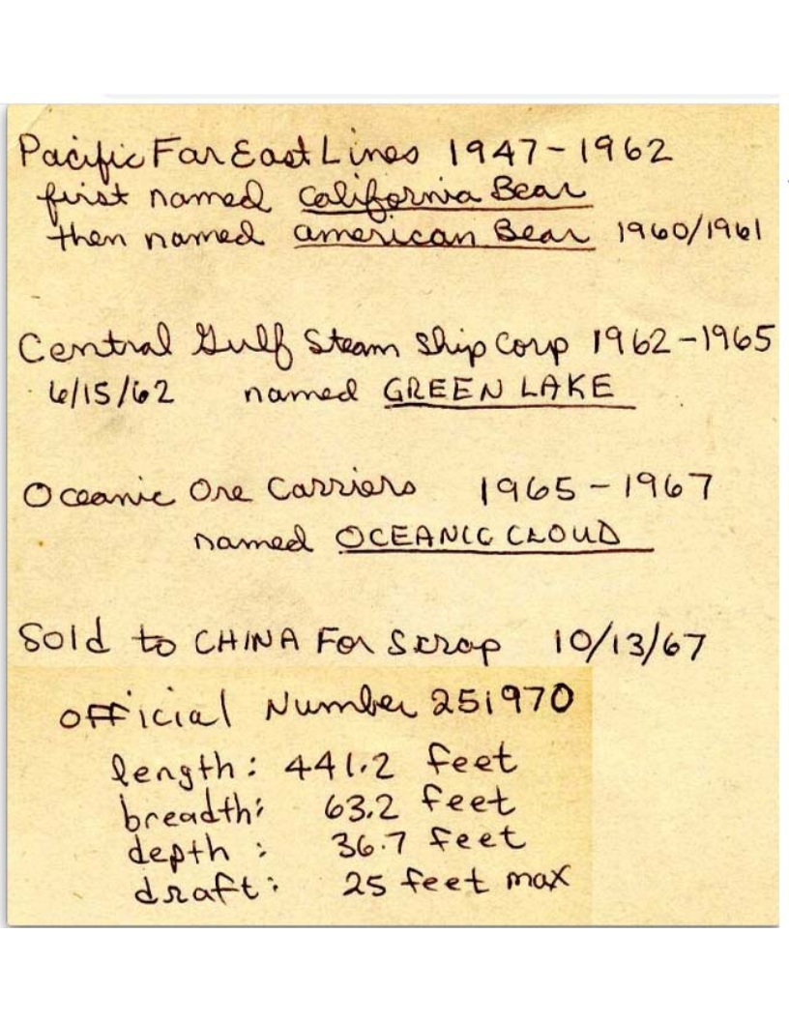
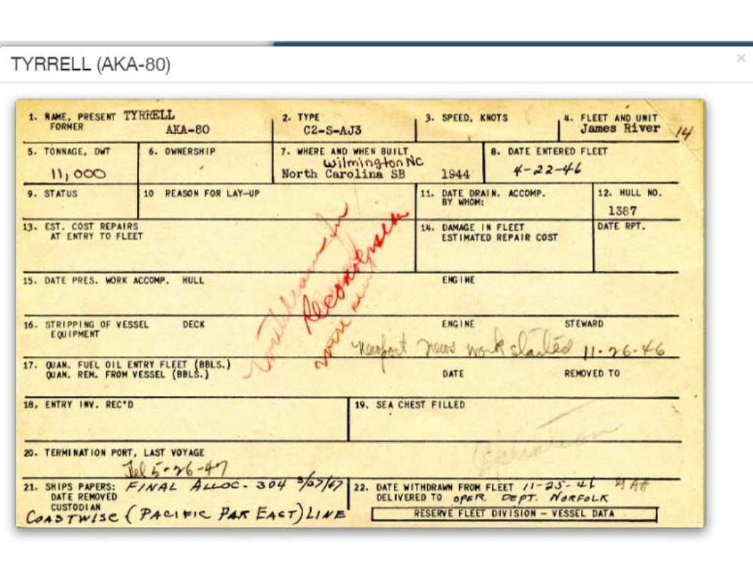
Tyrrell (AKA-80)

Slide 17
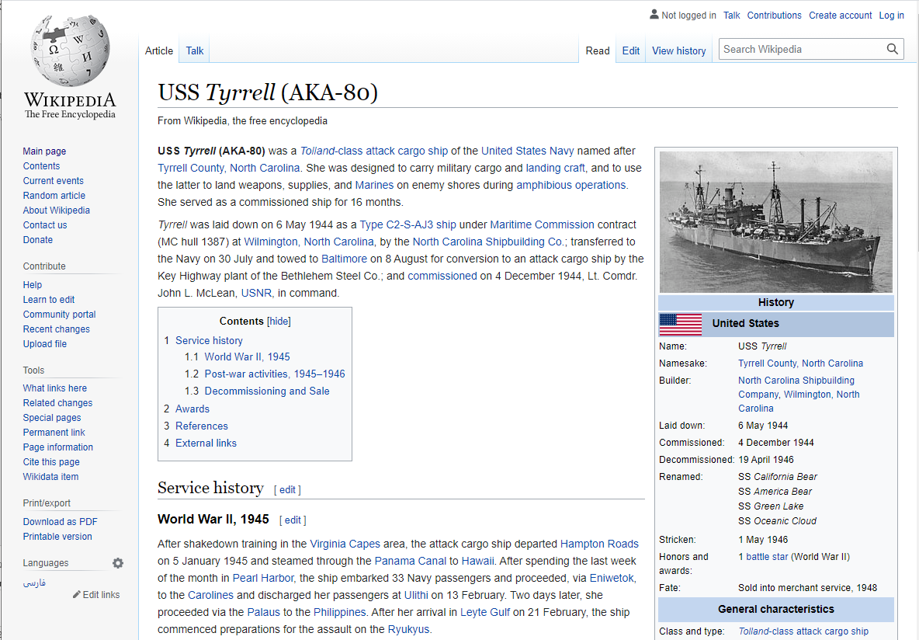
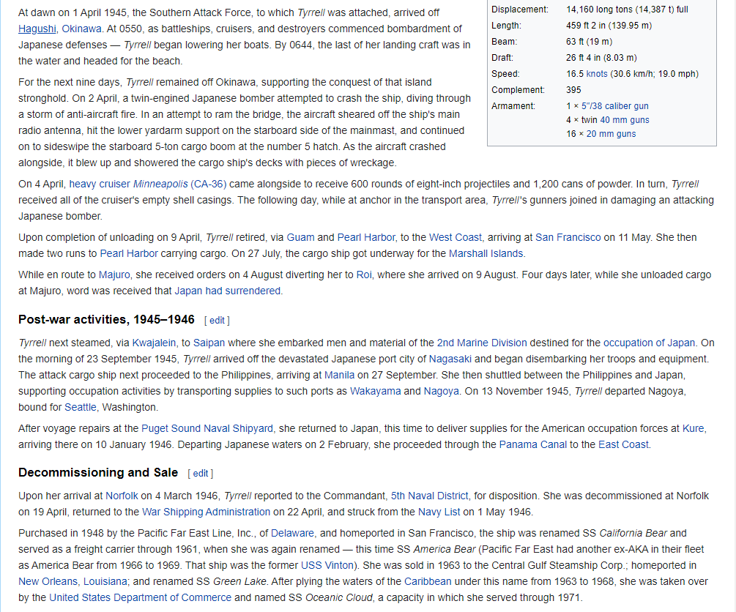

Slide 18
Ship-Breaking: Looking Forward
New regulations passed in December 2019 seek to limit this toxic trade, banning the EU from exporting its hazardous waste to the developing world.
This growing awareness has come too late for the thousands already exposed to hazardous materials on the beaches of South Asia. Cases of mesothelioma from ship-breaking may not manifest for 40 years.
The ship-breaking communities of India, Bangladesh and Pakistan can take steps to prepare for this, by modifying their local laws to allow for foreign liability.
Our ability to trace the ownership of the ships and the manufacturers of the asbestos containing materials onboard may potentially offer justice to workers and their families facing death from mesothelioma.

Slide 19
References
Beckett, William S. "Shipyard workers and asbestos: a persistent and international problem." (2007): 639-641.
https://www.shipbreakingplatform.org/
Wu, Wei-Te, et al. "Cancer attributable to asbestos exposure in shipbreaking workers: a matched-cohort study." PloS one 10.7 (2015).
Muralidhar, Venkiteswaran, Md Faizul Ahasan, and Ahad Mahmud Khan. "Case Report: Parenchymal asbestosis due to primary asbestos exposure among ship-breaking workers: report of the first cases from Bangladesh." BMJ Case Reports 2017 (2017).
Singh, Richa, et al. "Assessment of the future mesothelioma disease burden from past exposure to asbestos in ship recycling yards in India." International Journal of Hygiene and Environmental Health 225 (2020).
https://vesselhistory.marad.dot.gov/ShipHistory/Detail/4967 accessed 3/1/2020

Slide 20

Questions?
Please feel free to email the author Steven Kazan at skazan@kazanlaw.com

